Slide 1
Parts of the Theatre
“If I am Going to be a tree, doggonit I will be the best tree the world has ever known!!!”
Author: I made it up so it’s a meeeeeeuh

Slide 2
Parts of a stage or theatre….
First let’s just say that every part of a theatre has a specific name.
Here we will discover the REALLY, Really, really important ones that you yourself will find yourselves in, in the not so distant future…
AND SO DARLING IT BEGINS

Slide 3
The SET
The Set is The physical surroundings where the action of a play takes place.
The set is designed and built by technicians to best represent the play’s location.
For example, if a play’s action happens in a kitchen, the set might include a door, a table and chairs, a sink, a refrigerator, and an oven.

Slide 4
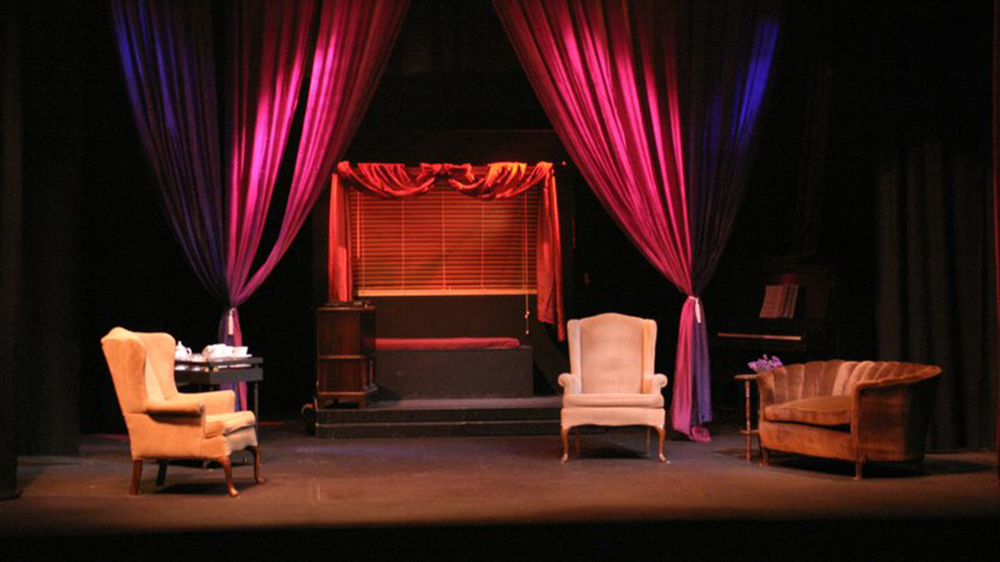
Example of a SET

Slide 5
Backstage
The area behind the set or off the stage that’s not seen by the audience.

Slide 6
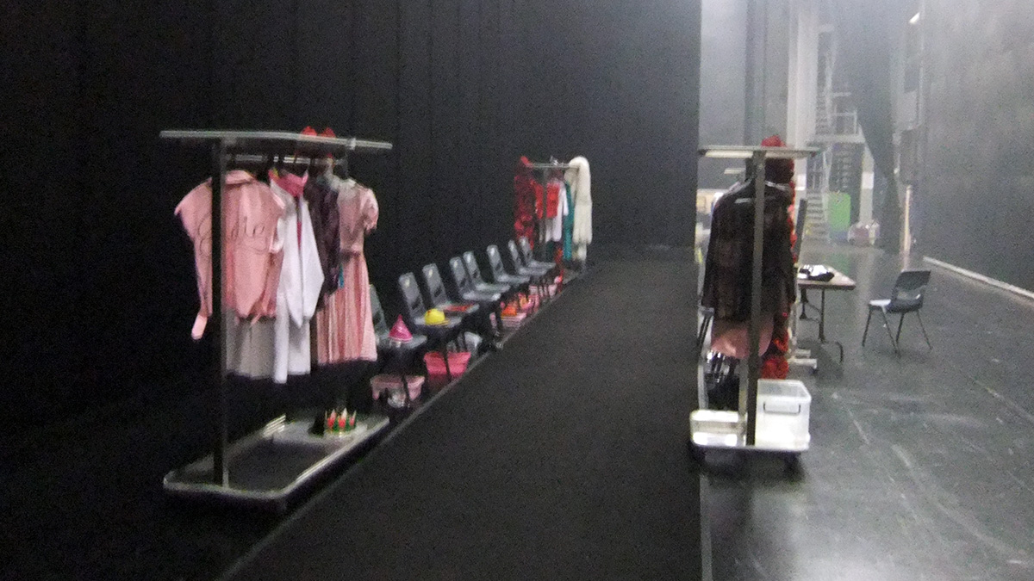
An Example of the Backstage Area

Slide 7
APRON
The area of the stage that’s just in front of the curtain.

Slide 8
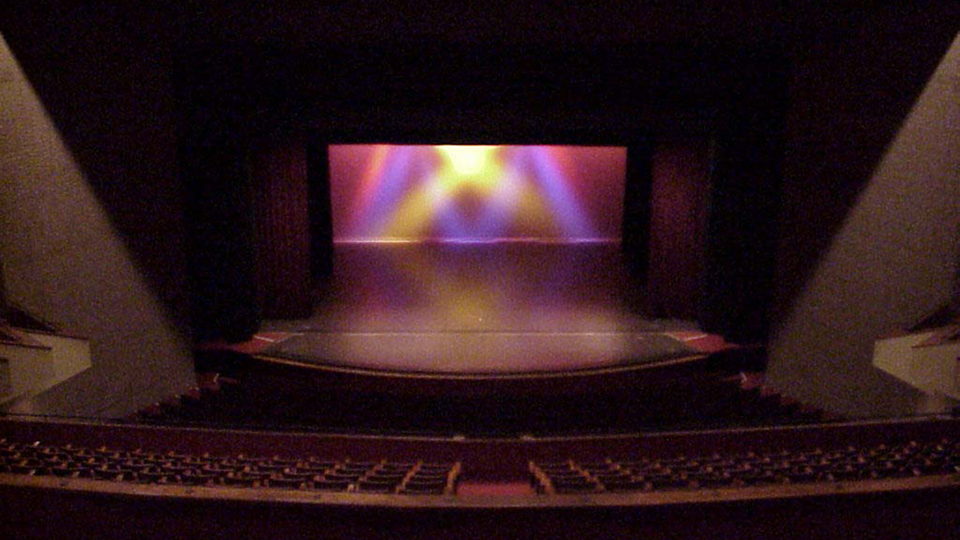
Example of an Apron

Slide 9
PIT OR ORCHESTRA PIT
(Where the music people are, heard but never seen kind of)
The area where musicians sit during a performance. The pit is just off the stage, in a low area between the front of the stage and the audience.

Slide 10
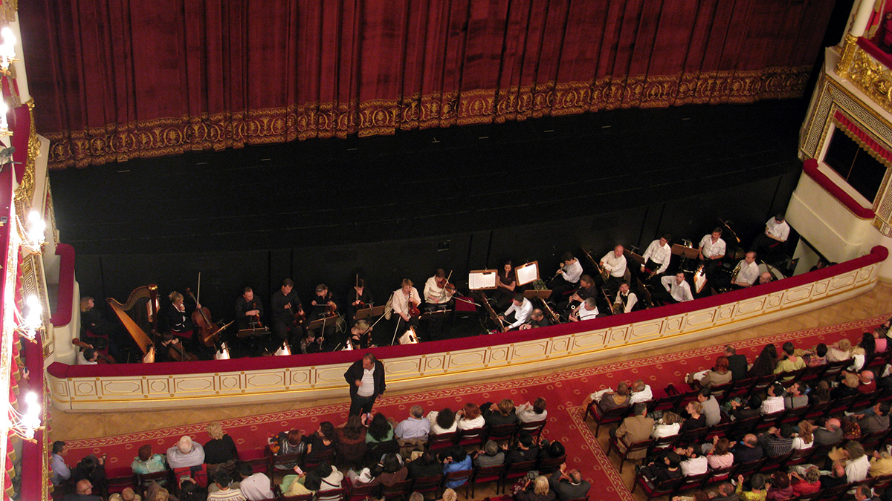
Example of a Pit/Orchestra Pit

Slide 11
Proscenium Arch
The area that frames the stage.
And yes, it sometimes looks like a giant picture frame.

Slide 12
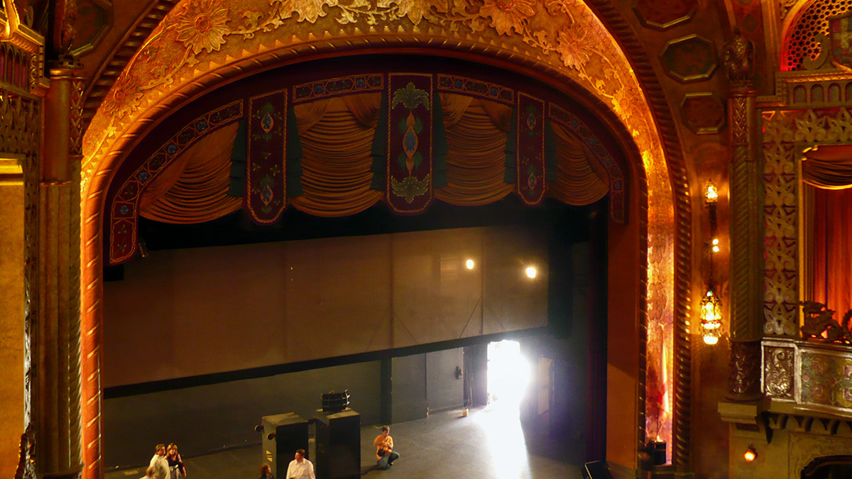
Example of a Proscenium Arch

Slide 13
Crossover Space
The area behind the set that actors and technicians use to move from stage left to right without being seen by the audience.

Slide 14
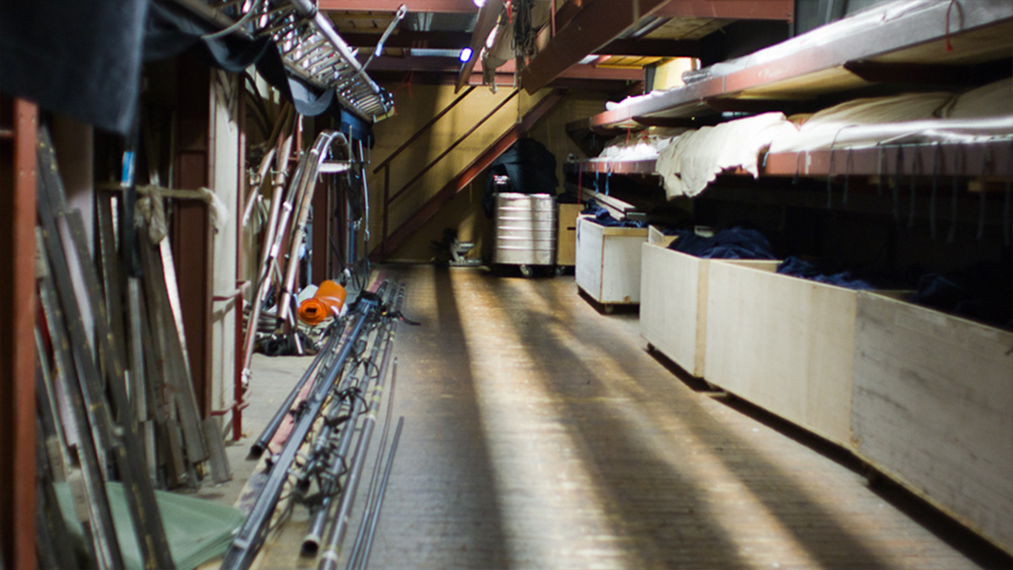
Example of a Crossover Space

Slide 15
Trap Door
A hidden door that’s built into the stage floor (or sometimes the stage wall).
It allows actors to make surprising and dramatic entrances and exits from hidden places underneath or behind the stage.

Slide 16
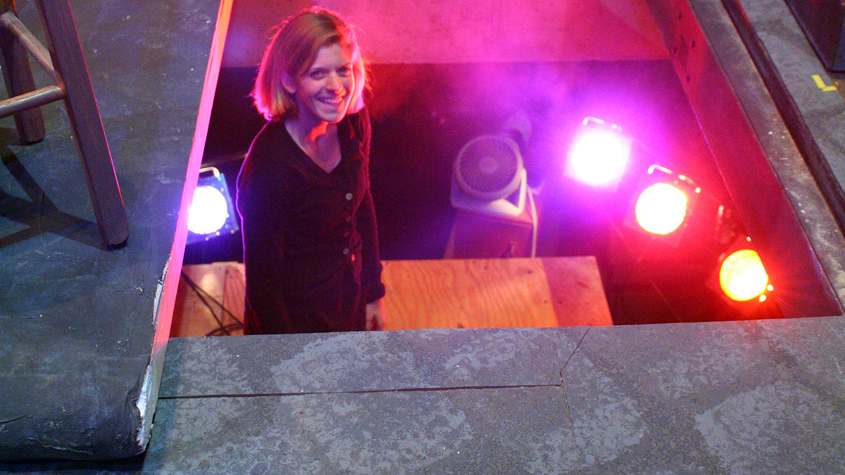
Example of a Trap Door

Slide 17
The Legendary WINGS
The areas just off stage left or stage right, not seen by the audience.
The actors wait here immediately before they go onstage.

Slide 18
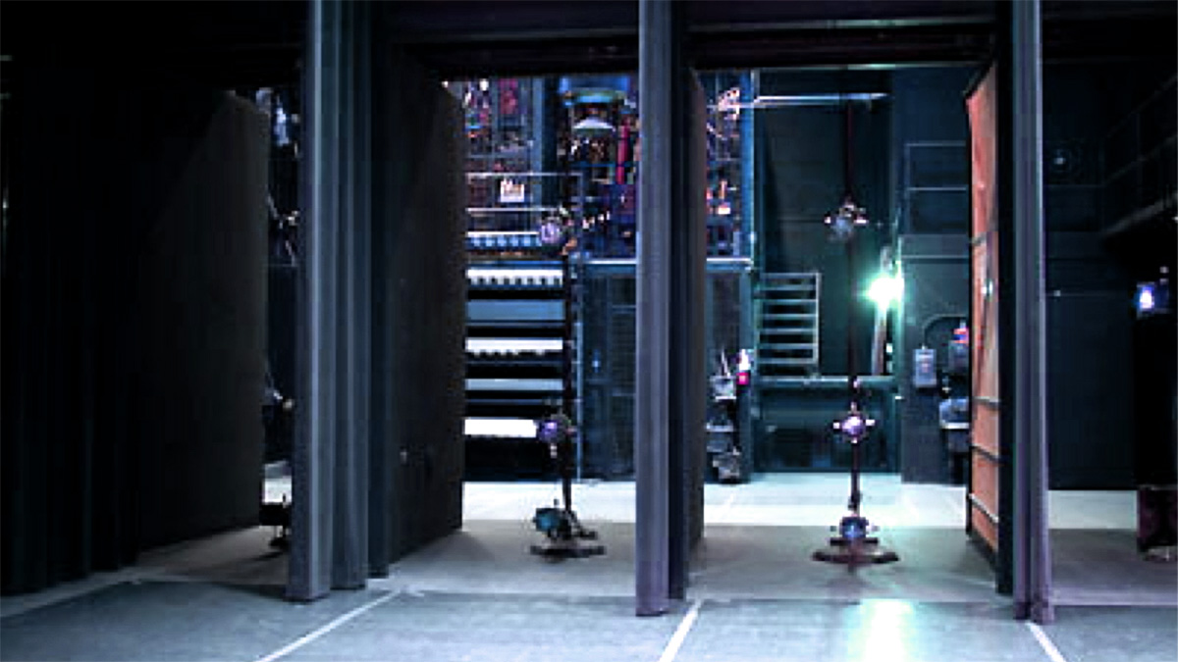
Example of the Wings

Slide 19
I Hope That’s All
BUT WAIT THERE’S
MORE

Slide 20
Parts of the Theatre that are most definitely off-stage
Not all the “action” happens on the actual stage. Here are some other important places…

Slide 21
The HOUSE
The seating area of a theater. When you’re in the audience and watching a show, you’re sitting in the house.
Sometimes, the audience itself is called the house. When someone asks, “How big is the house tonight?”
they’re asking how many people are in the audience.

Slide 22
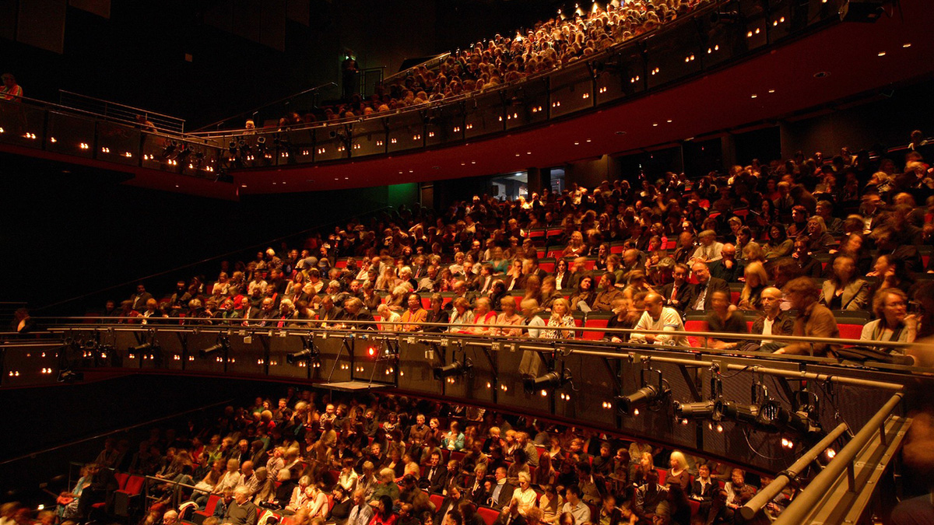
Example of The HOUSE

Slide 23
Because Houses are not small but rather large they include…
House left/house right:
The area in the house that’s to the audience’s left or right.
Back of House (BOH):
The part of the theater that is not open to the public and is used by technicians or actors. For example, backstage areas are back-of-house areas.
Front of House (FOH):
The part of the theater that is used by the audience.
For example, a theater’s lobby, box office, and refreshment stand are front-of-house areas.

Slide 24
The Orchestra
The seating area that is closest to the stage in the main part of the house.

Slide 25
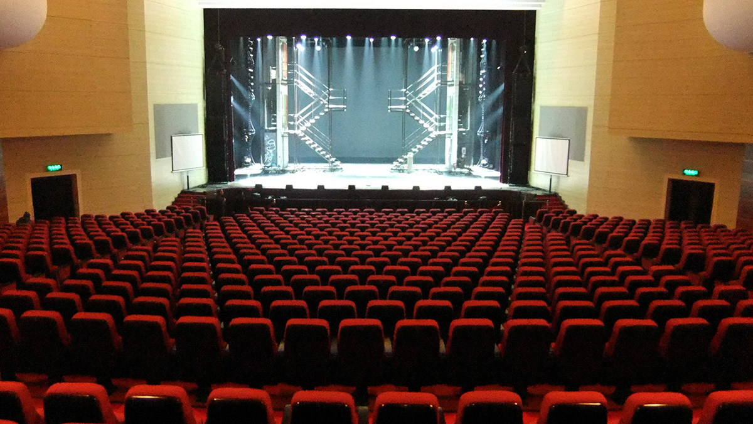
Example of the ORCHESTRA

Slide 26
The Balcony
The upper part of the house.
It sometimes overhangs the main part of the house.
Large theaters often have more than one balcony.
The lowest balcony in a theater, or the first few rows of a balcony is called the Mezzanine.

Slide 27
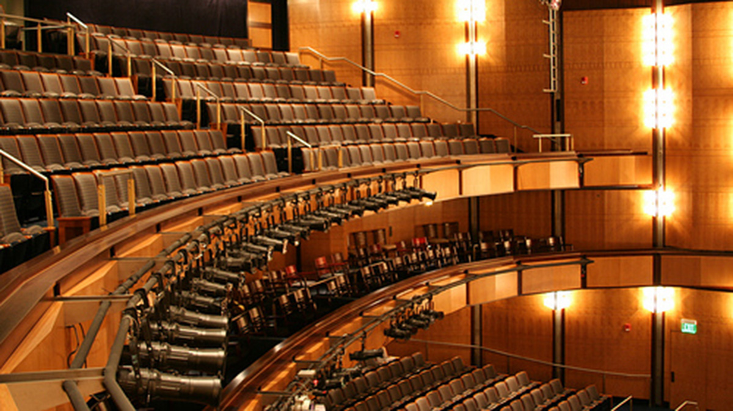
Example of the Balcony

Slide 28
The BOOTH
The area or room from where technicians control the lights and sound for a show. The booth is usually at the back of the theater and is usually soundproof. It lets technicians see the performance without being in the theater.
This is where the Sound/effects and light shows are produced.

Slide 29
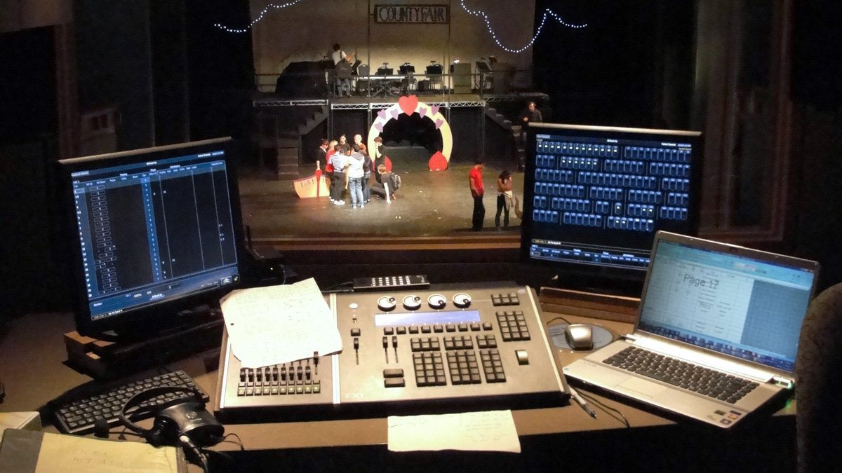
Example of a Booth

Slide 30
The Infamous CATWALK
A narrow metal bridge or walkway that’s usually very close to the ceiling and above the stage and audience.
Technicians use the catwalk to reach and adjust the lights and other equipment.

Slide 31
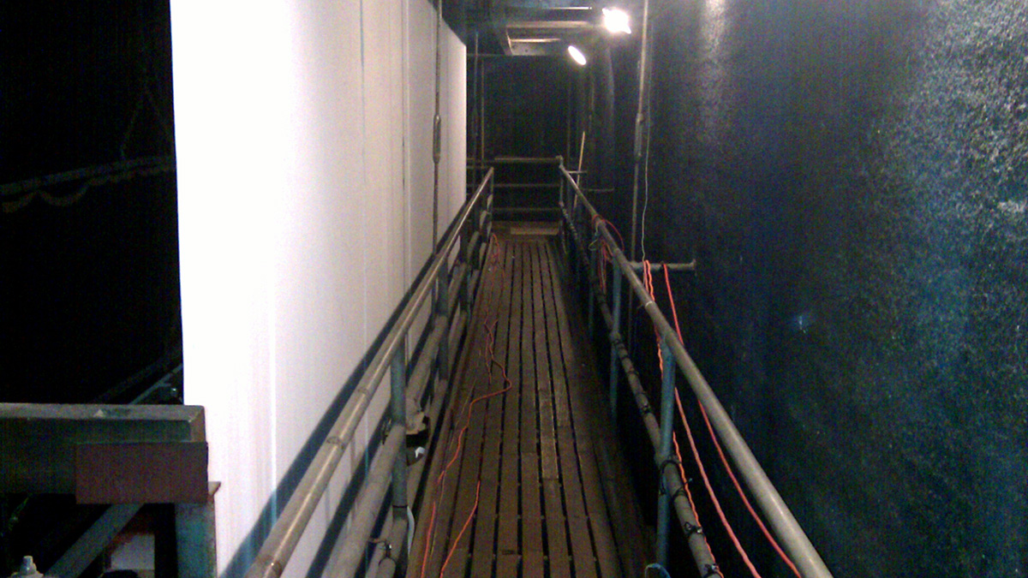
Example of a Catwalk

Slide 32
The Dressing Room
A backstage room where the actors dress and apply makeup before they go onstage.

Slide 33
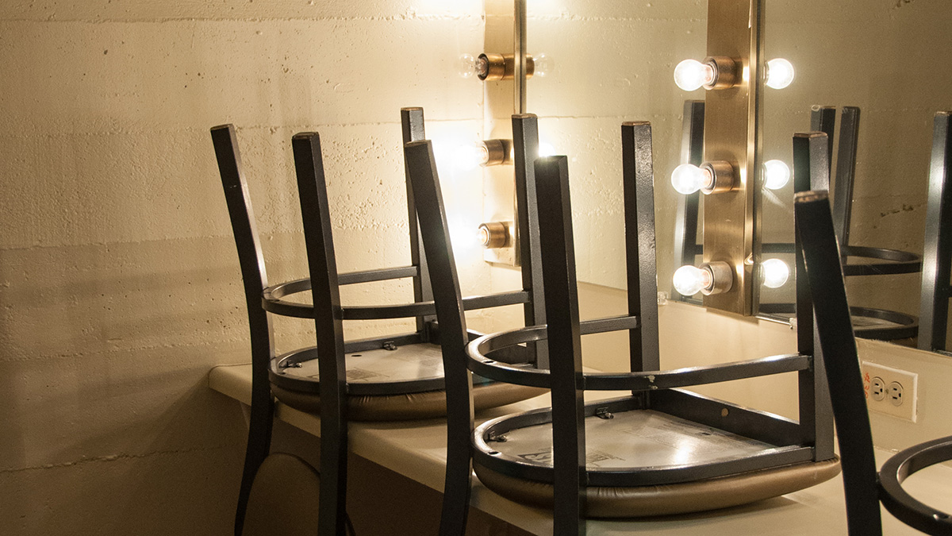
Example of a Dressing Room

Slide 34
The Green Room
A backstage room where the actors wait before they go onstage.
Actors sometimes relax in the green room before or after the show.

Slide 35
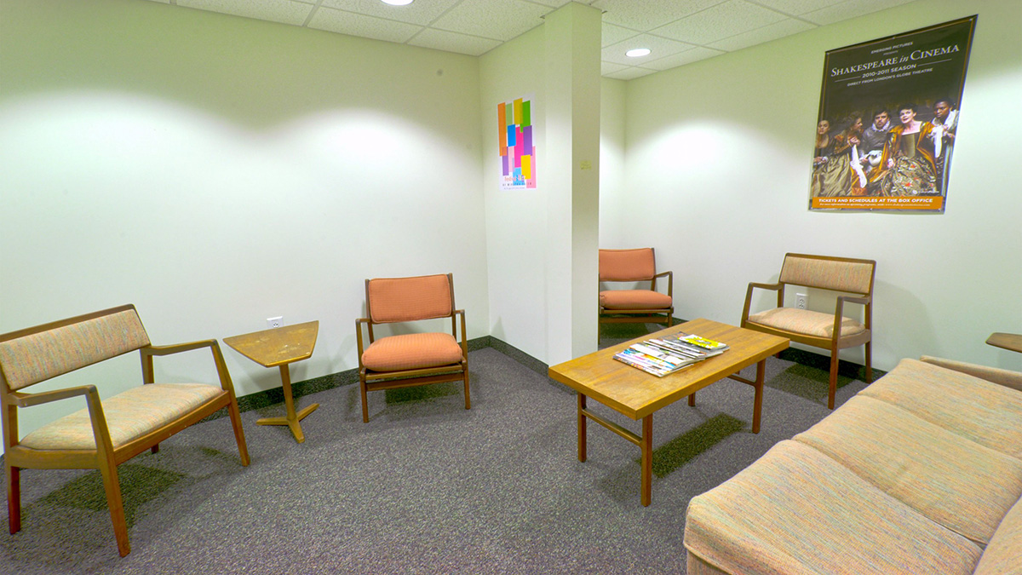
Example of a Green Room

Slide 36
The GRID
A supporting structure that hangs near the ceiling, above the stage or house. Lights and scenery are attached to the grid.
When a lighting technician “hangs” a light, it means that he attaches a light to the grid.

Slide 37
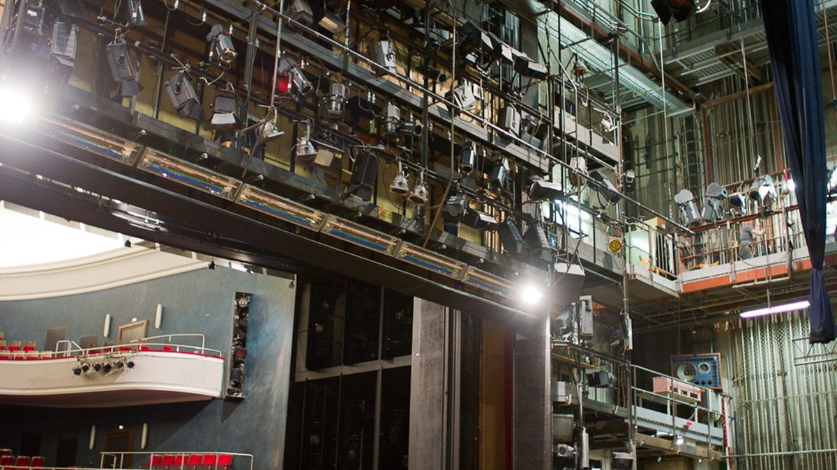
Example of a Grid

