Slide 1
THEATRE HISTORY 101
AUGUST &&, 2021

Slide 2
Theatre & Drama
So Exactly
Where did it come from??

Slide 3
A long long time ago in a time far away….

Slide 4
Where did Drama & The Performing Arts get it’s start?
The earliest origins of drama are to be found in Athens of Ancient Greece.
It is here that ancient hymns called dithrambs were sung in honor of the god Dionysus .
These hymns were later adapted for choral Processions, where those participants would dress up in costumes and masks.
They were not yet the actors in the way that we would understand it.

Slide 5
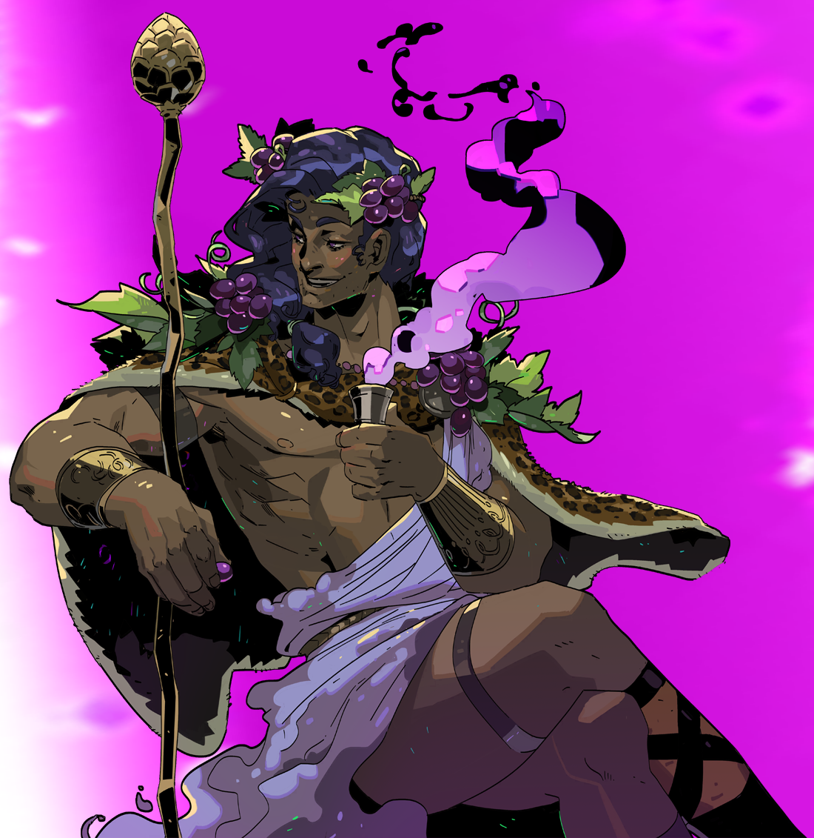
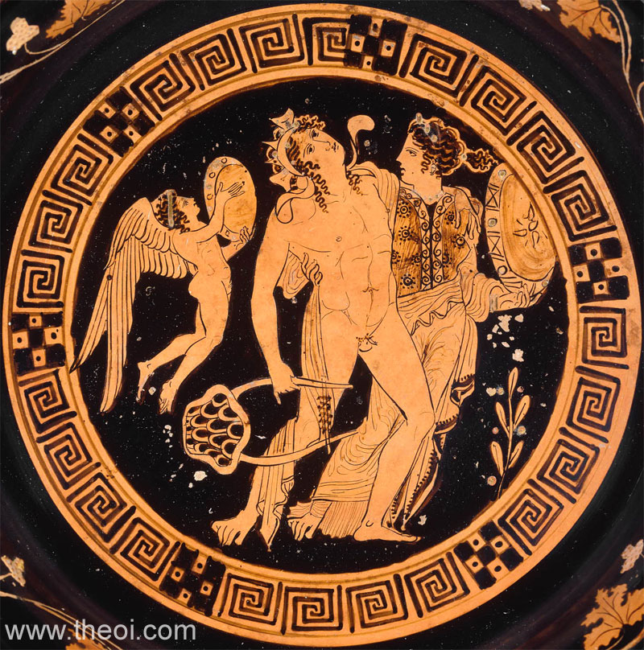
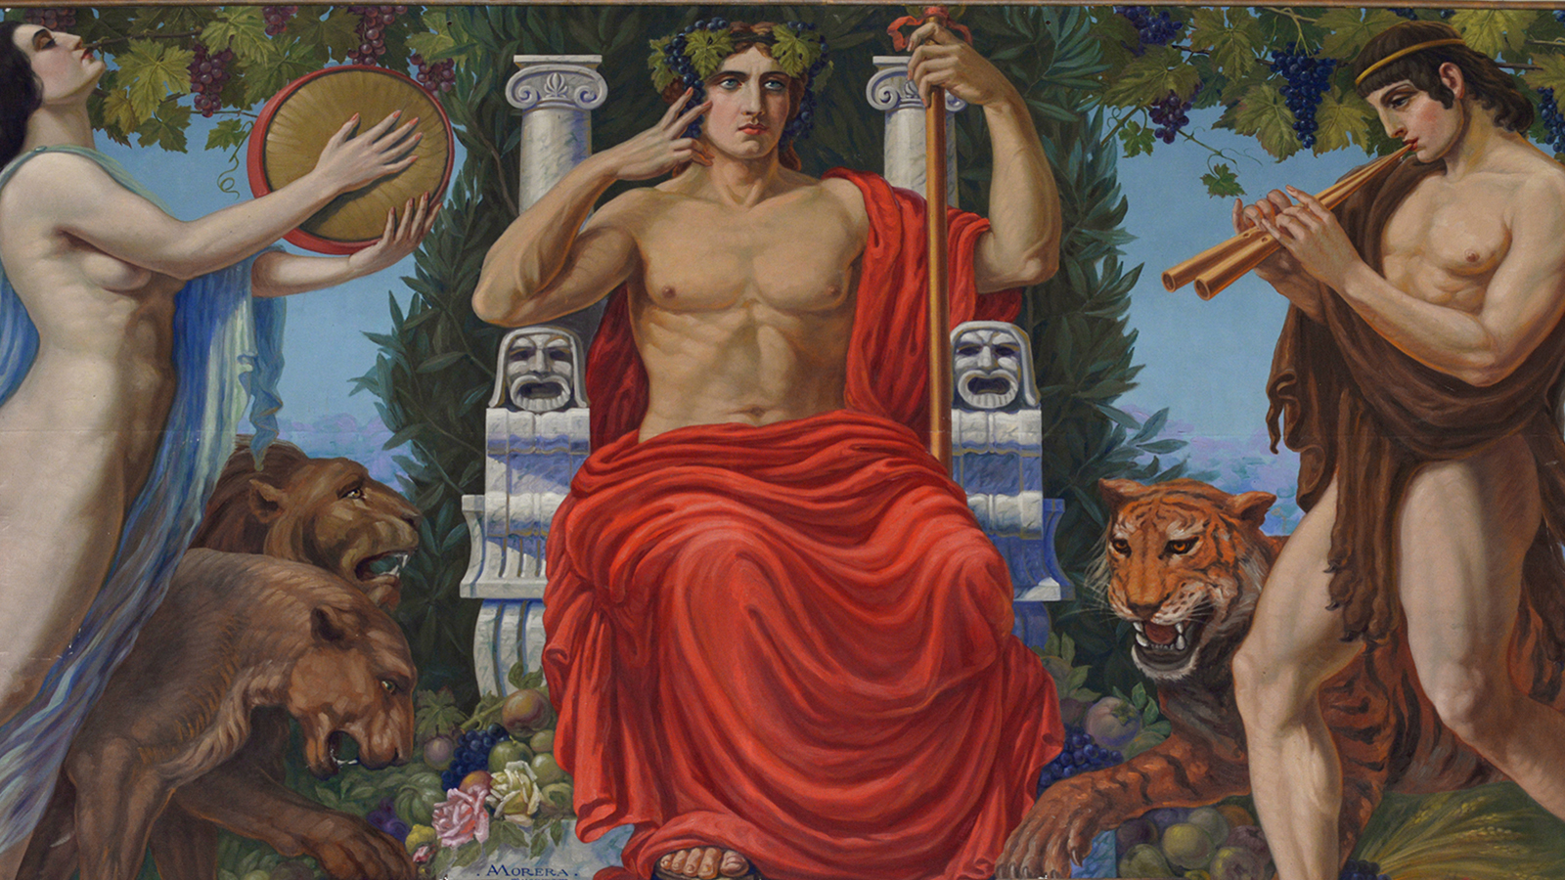
DIONYSUS
Dionysus was the Olympian God of wine, fertility, vegetation, pleasure, festivity, madness, and frenzy.
He was the son of Zeus & Semele
He was the ONLY God with a mortal parent.
Later he was considered to be a patron of the arts.
He had a dual nature meaning on one hand he brought joy and divine ecstasy and on the other brought brutal blinding rage.
This reflected the dual nature of wine in which he is known for.
His mother was instantly burnt to a crisp after Zeus revealed himself in his true form and Zeus rescued the fetal Dionysus and stitched him in his thigh until he was ready to be born.
Hera (Zeus wife) who was still angry had the Titans rip Dionysus to pieces and he was then brought back to life by Rhea.
After these events Zeus arranged for his protection and gave him the mountain nymphs to be raised on.
He had 9 children: Priapus, Hymen, Thoas, Staphylus, Oenopion, Comus, Phthonus, The Graces and Deianira.
Talk about your family problems/issues

Slide 6
Dionysus’ Key Concepts
One of the most important gods in everyday life.
Associated with several concepts
Rebirth after death
Possessed by a greater power
(under the influence of wine)
The Festival for Dionysus
The Festival was held in spring, when the vines would start bearing leaves.
One of the most important events of the year.
It’s primary focal points was the theater.

Slide 7
Olympian Gods

Slide 8
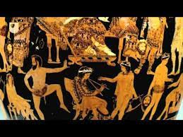
So what does that have to do with theater, drama, & acting???

Slide 9
Lets Go Back to Athens…
The development of acting came later in 6th Century B.C. (Before Christ), by tyrant Pisistratus, who then ruled the city
Established a series of new public festivals
One of these, the 'City Dionysia', a festival of entertainment held in honor of the god Dionysus.
It featured competitions in music, singing, dance and poetry.
The most remarkable of all the winners was said to be a wandering bard called Thespis.
I’ve Heard that word before……so it is actually associated with a person, I want to know more about this Thespis character….

Slide 10
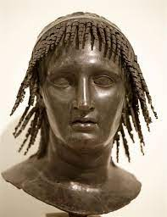
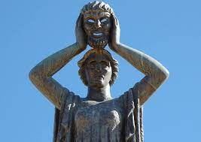
Thespis
According to tradition, in 534 or 535 BC, Thespis astounded audiences by leaping on to the back of a wooden cart,
Reciting poetry as if he was the characters whose lines he was reading.
In doing so he became the world's first actor
It is from him that we get the word thespian.

